Slide 1
Hosted VoiceClock
Procedures

Slide 2
Discussion Items
1. Addressing Incoming Tickets
2. The Hosted VoiceClock Request Form
3. Time Device Management
4. Assigning a Client to a Hosted VoiceClock
5. Submitting a Request to USTelePunch
6. USTelePunch Response
7. Issues with the Process
8. Other things of Note

Slide 3
Addressing Incoming Requests
In most cases there will be a ticket and if not they will need to have one to start and document the process.
They will also need to fill out and attach the Hosted VoiceClock Request form which can be found in the Knowledge Base article 1081.

Slide 4
Hosted VoiceClock Request Form
Portions of the form to pay attention to and are unique to this process are under three sections.

Slide 5
Hosted VoiceClock Request Form
1. The Phone Number:
a. Shared Local – This is checked if they will be using the generic phone line.
b. Private Local – This is if they will be requesting a custom phone number for the client. If so they will also need to fill out the section below “Preferred Area Code/Prefix (optional)” where they will list the area code for their private number.

Slide 6
Hosted VoiceClock Request Form
2. Please check the features you would like enabled for this customer:
a. Punch IN – This should always be checked.
b. Punch Out - This should always be checked.
c. Transfer – This is if they are using clock prompts.
d. Caller I.D. Restrictions – This is if they will be restricting usage based on a phone number list they will have to provide.

Slide 7
Hosted VoiceClock Request Form
3. FOR INTERNAL SWIPECLOCK USE ONLY:
a. Device I.D. - This is something we generate on our end and is explained later under the “Time Device Management” section.
b. DeviceSecret – This is something we generate on our end and is explained later under the “Time Device Management” section.
c. SiteNumber – The Clients Site Number.

Slide 8
Time Device Management
Time Device Management is used to set up the API for the Reseller and is found under:
Sys Admin Menu > Time Device Management
From that point we or the Reseller can assign the Hosted VoiceClock API to the client.

Slide 9
Time Device Management
Reviewing Time Device Management

Slide 10
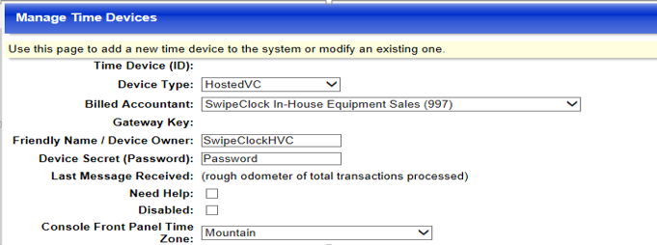
Time Device Management
Setting Up a New API under Time Device Management

Slide 11
Assigning a Client to Hosted VoiceClock
Next will to assign the client to the Hosted VoiceClock API by going to:
Accountant Menu > Add / Edit VoiceClock
From there select the “Add New” link and at the next page select the “Friendly Name” you used when you reviewed/created the API for the Reseller then click on the “Save” button.

Slide 12
Requirements for the Reseller’s Client
THIS IS VERY IMPORTANT:
In order for the integration to work the Reseller will need to have employees assigned to the client account.
The employees will also need to have a numeric login/card number in place before USTelePunch will be able to verify a successful sync through the API.

Slide 13
Requirements for the Reseller’s Client
If the client will be using the “Transfer” feature (clock prompts) they will need to configure this and provide an approved list when setting up the prompts.
USTelePunch cannot do a successful sync unless there is a list set for their clock prompts.

Slide 14
Submitting the Request to USTelePunch
You will be sending the request form attached to the below email:
amanda.borg@ustelepunch.com
The email should include the below the subject:
Hosted VoiceClock Request

Slide 15
Submitting the Request to USTelePunch
Other items to include in the request are:
Client Name: <The Clients Name>
Site ID: <The Clients Site ID>
Device ID: <The Device ID discussed in the “Time Device Management” you assigned to the client>

Slide 16
Submitting the Request to USTelePunch
DeviceSecret: <The DeviceSecret discussed in the “Time Device Management” you assigned to the client>
TimeZone: This will be the time zone for the client found under Accountant Menu > Time Zones > “Base Time Zone”
Transfer Information: We will need to provide what clock prompt they are using as well as what the name of the prompt is.

Slide 17
USTelePunch Response
We inform all Resellers that the wait time can be from 5 to 10 business days for this to be completed.
USTelePunch will usually respond if it is for a generic number set up within a day or two.
With the generic number they will provide a third piece of authentication needed called the company code.

Slide 18
USTelePunch Response
With custom phone numbers it can take longer for the request. There is also the possibility that the area code they are requesting is not available and they will offer suggestions as far as something similar. You will need to relay this back to the Reseller via the Support Ticket.
A company code is usually not required as the client will have their own custom number.

Slide 19
USTelePunch Response Times
Once we get a response from USTelePunch you should be able to release the needed information to the Reseller for testing.

Slide 20
Issues with the Process
In most cases any issues that have come up are with USTelePunch not being able to complete a sync to use due to something missing in the client’s setup (no employees or employees not having a numeric login/card number).
If they are using the “transfer” option it could also mean the client has not set up the prompts correctly.

Slide 21
Other things of Note
Articles in the Knowledgebase on Hosted VoiceClock
Wiki Articles on Hosted VoiceClock. The wiki will also have other USTelePunch contacts if there are communication issues or found technical issues to resolve.
Desk.com also includes templates for Hosted VoiceClock responses.
Feel free to contact me (Keoki) with any questions.

